Slide 1
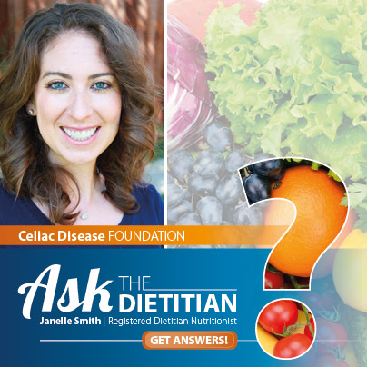
Back To School
& 504 Plans
Andrea Levario, JD
former American Celiac Disease Alliance
Janelle Smith
CDF Registered Dietitian Nutritionist
August 24, 2016 - 1 pm PST

Slide 2
Today’s Webinar
504 Plans with Andrea Levario, JD
School food service basics
Nutrition and recipes for every grade

Slide 3
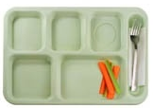
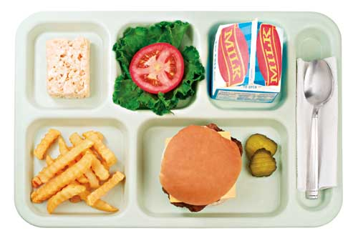
504 Plans for Students with Celiac Disease Andrea Levario, J.D.

Slide 4
Overview
504 Plan
Process
Partnership
Protection for Individual Student

Slide 5
Federal Disability Laws
Americans with Disabilities Act (ADA)
Section 504 Rehabilitation Act 1973
- Applies to public schools
- Applies to most private schools
- Applies to public schools
- Applies to limited private schools

Slide 6
What is Section 504?
Part of the Rehabilitation Act of 1973
Federal civil rights law
All qualified persons with disabilities within the jurisdiction of a school district are entitled to a free appropriate public education

Slide 7
Celiac Disease = Disability?
Must meet this standard –
The individual student has a physical or mental impairment which substantially limits one or more major life activities.

Slide 8
“Major Life Activities”
Learning
Working
Eating
Caring for one’s self
Performing manual tasks
Walking
Seeing
Hearing
Speaking
Breathing
Notes:
8

Slide 9
The Process
Request for services
Student evaluation
Determination of eligibility
Plan drafted, approved, implemented

Slide 10
What to Document
Identify the disability
Explain how it restricts the child's diet
Major life activity affected
Foods to be omitted
Foods to be substituted

Slide 11
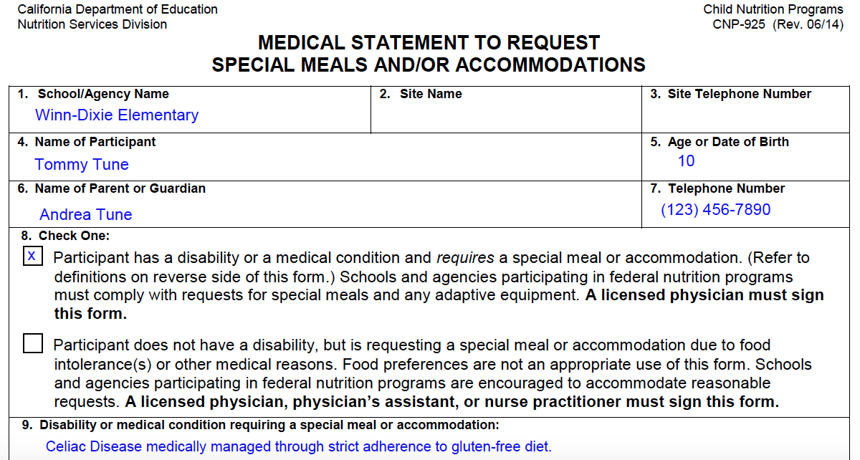
Medical Statement

Slide 12
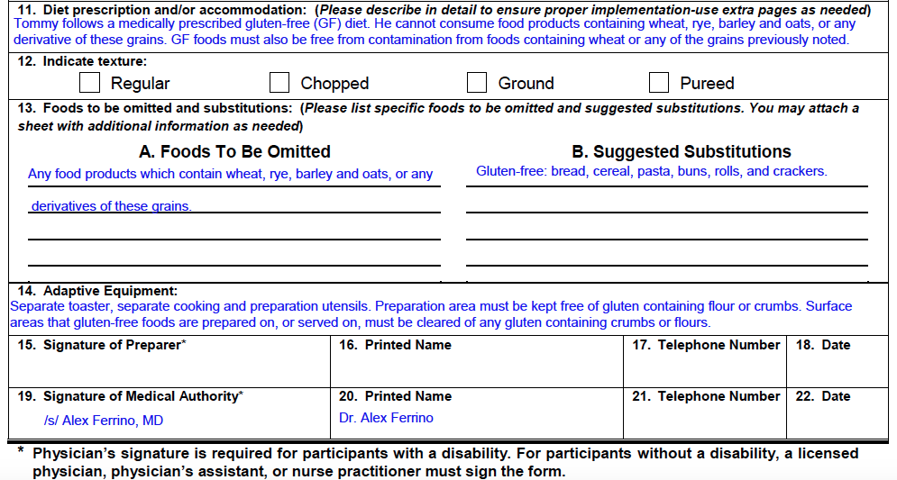
Medical Statement (cont.)

Slide 13
Scope of Section 504
Section 504
Class
Lunch
Field Trips
ER

Slide 14
The 504 Plan
Objectives / goals of the plan
Meals and snacks
Bathroom access
Classroom activities (art projects)
Field Trips / extracurricular activities

Slide 15
504 Plan (cont.)
Communication
Emergency evacuations / shelter-in-place
Parental notification
Emergency contacts

Slide 16
Attention in the School Kitchen
Food prep areas
Dedicated work spaces and/or equipment
Clean and sanitize
Label reading

Slide 17
USDA Accommodations
Required
With Approval
Allergies with the potential of anaphylaxis
Celiac disease
Allergies with no anaphylaxis
Food intolerances

Slide 18
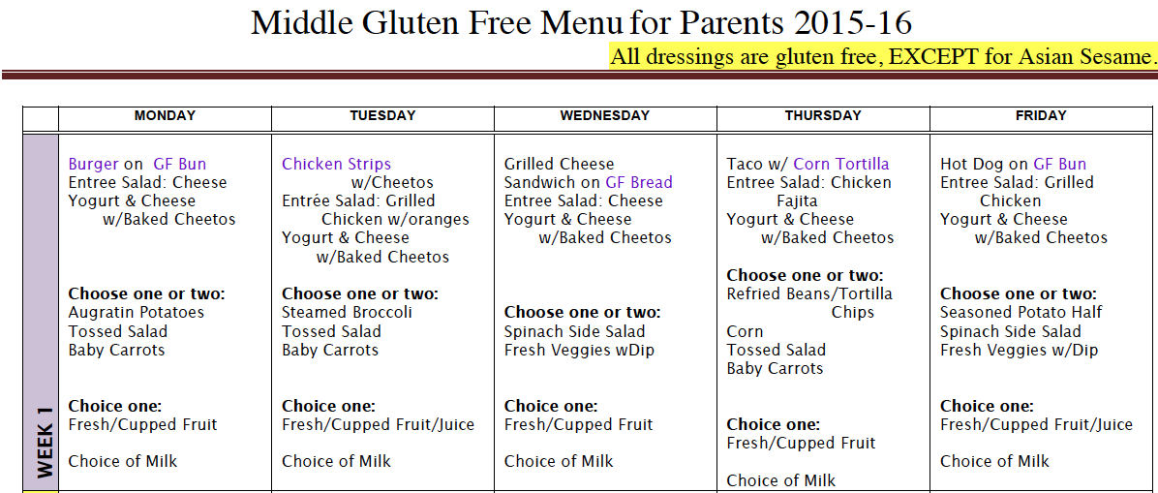
Chesterfield County, VA Middle School Gluten-Free Menu

Slide 19
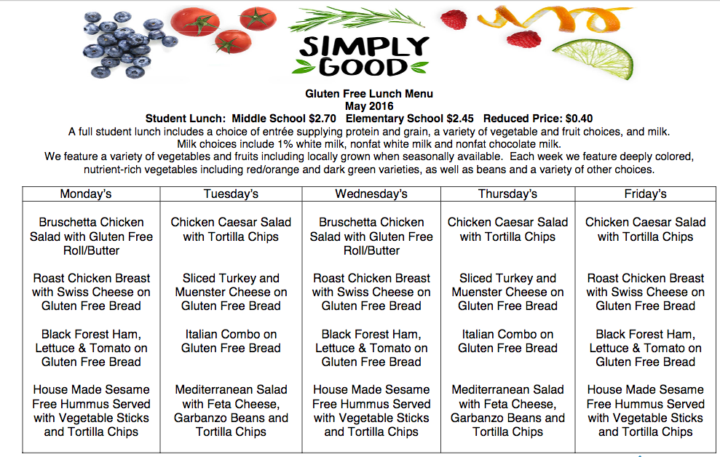

Slide 20
Helpful Notes for Dietitians
Know what the USDA meal pattern requirements are so that you can assist the school in developing the child’s personalized diet plan.
Be knowledgeable of the policies and procedures in place for the State and local district as they pertain to children with identified special dietary needs

Slide 21
Resources
CDF Website
Foodallergy.org
Centers for Disease Control and Prevention (CDC)
“Voluntary Guidelines for Managing Food Allergies In Schools and Early Care and Education Programs”

Slide 22
Thank you

Slide 23
USDA Meal Pattern Requirements
Lunch MUST contain: Breakfast MUST contain:
fruit fruit or vegetable
vegetable grain
grain milk
protein (meat or meat substitute)
dairy
Meet limits for saturated fat, sodium, and trans fats
Grains MUST:
Contain at least 50% whole grain
Meet a minimum serving size per grade level
Dairy - includes lactose-free and milk substitutes
http://www.fns.usda.gov/usda-foods

Slide 24
Preschool & Kindergarten
High level of parent involvement
May need to provide all meals/snacks if caregivers are not reliable
Ask for high amount of monitoring at meal times to ensure gluten-containing items are not put in mouth
Special placemat to signify to child to only eat what’s in “their area” or “their lunchbox”
Wash hands before meals
Ask for high amount of monitoring during crafts/activities involving gluten:
dry pasta crafts
play dough
face paint
sand trays

Slide 25
Preschool & Kindergarten Nutritional Needs
Except for gluten, trust your child’s ability to feed themself
Children are intuitive eaters. Every meal may not be balanced, but they will regulate their intake over longer periods of time
Food aversion is common when diagnosed at a young age. Focus on the foods he/she likes and don’t fight with the “picky” eater
Make meal times fun and enjoyable with games and positive talk
Work with an occupational or behavioral therapist if needed
Catch-up Growth
weight-gain supplements like Pediasure
whole milk (lactose free if necessary), added fats like coconut oil, nut butters
liquid vitamins, especially iron

Slide 26
Elementary School 1. Talk with Administration
File a 504 plan
Model plan at Celiac.org/Ask
School Nurse may create an “individualized nursing plan” for bathroom passes, time laying down, etc.
Emergency kit
“Back-up lunch” (non-perishable)
Back-up underwear/pants for GI accidents
Absence excusal
Learning needs assessment or independent study as necessary

Slide 27
Elementary School 2. Work with Teachers/ Aids
Explain your child’s symptoms
Ask for advance notice of class parties, field trips, prizes
Keep an eye out for bullying or teasing
May need bathroom pass
Give your teacher non-perishable goodies for last-minute occasions
Volunteer for Room Mom or PTA

Slide 28
Elementary School 3. Preventing Cross-Contact
Please no classroom activities with loose flour
Wash hands before lunch
No “snack swapping” with friends (until they are excellent at label reading)
Start teaching label-reading to your child
GF label and “contains wheat” are easiest to spot
Practice reading words from food labels!
School food service must provide EQUAL accommodations to students with disabilities (ensured via 504 plan)
Include prevention of cross-contamination in 504 plan
GF bread or other GF starch must be included to meet all food groups in a balanced meal
Identify students in lunch line via special sticker or ID card

Slide 29
Elementary School 4. Inclusion & Community
School confidentiality and anti-bullying policy applies to health needs
Bring GF treats for the whole class – show peers that it tastes good!
Encourage your child to use celiac for a school project/presentation (more later!)
Empower your child to talk about their needs
Keep snacks/frozen meals at friends’ houses

Slide 30
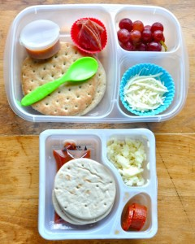
Kid-Friendly GF Lunchbox
Re-create Lunchables
Eat the rainbow in every lunch
Sneak in vegetables and fiber
Udi’s pizza crusts
Mission tortilla wraps
Glutino English Muffins
Enjoy Life – allergen free products
Betty Crocker, Bisquick & Chex help your kiddo feel normal

Slide 31
Kid-Friendly GF Lunchbox
Recipes on Celiac.org:
Loaded pizza sauce
Black bean brownies
Zucchini muffins
Tortilla wraps
Overnight oats
Pretzel-crusted chicken strips
Breakfast quiche cups

Slide 32
Middle & High School 1. Talk with the School
School Psychologist
School Nurse
Home Room Teacher
Extracurricular leaders
File a 504 plan
Access to GF food in classroom and cafeteria
Excused absence from activities that use gluten-containing foods or materials, i.e. Home Ec, food science
Prevent cross-contamination in school food service
Use of microwave to heat personal meals
Bathroom privileges

Slide 33
Middle & High School 2. Lunch & Social Events
Time to be proficient at reading labels and take more responsibility
Avoid salad bars with croutons and other crunchies, unlabeled salad dressing, flavored nuts
Ask questions of school food service – avoid anything without an ingredients list
Chips and other snack foods should be labeled GF
Bring your own dish to team dinners, birthday parties, friends houses
Keep back-up snacks (non-perishable) in backpack, locker, car

Slide 34
Brown Bag Lunches + Backpack-proof Snacks
Nature Valley bars
NoGii bars
Frito-Lay GF labeled chips
Rudi’s tortilla wraps
Schar baguettes, multigrain bread
Follow us on Instagram and Facebook for many more easy recipes and ideas!
@CeliacDiseaseFoundation

Slide 35
College 1. Choosing a School
Wish list:
Dining halls with dedicated GF products and prep areas
Allergen labels on all dishes
Local restaurants that have GF menus
On-campus dining with GF options
To Dorm or Not to Dorm?
Is the dining hall accommodating?
Can you waive the dining hall fee?
Is there room for a fridge and microwave in your dorm?
Any dorms with kitchenettes?

Slide 36
College 2. Navigating Dining Halls
Avoid salad bars with croutons and other crunchies, unlabeled salad dressing, flavored nuts
Scrambled eggs: check ingredients and cooking surface
Toaster bags, your new best friend
Individual condiment packets or squeeze bottles only
Avoid shared cereal containers/bulk bins
Emergency rations often at convenience stores:
cheese sticks, hardboiled eggs, yogurt, fruit, carrots & celery with ranch, peanut butter, nuts, plain potato chips

Slide 37
College 3. Social Life & The Freshman 15
Eat before going out with friends if you’re not sure that there will be GF options
Bring a snack bar in your purse/pocket
Have the alcohol discussion before it’s a problem
No malted beverages or beer. All hard liquors ok
No cider from a beer tap/keg – choose bottles and cans
Drinking games are chance for cross-contamination
Late-night eating should not be in addition to a full day of meals/snacks – spread out your meals
Limit liquid calories: smoothies, sodas, flavored coffee drinks, alcohol
Stay active – IM sports, classes

Slide 38
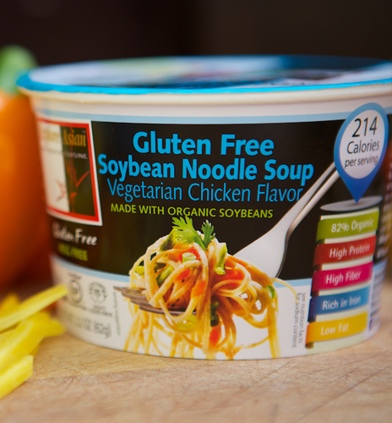
Easy Dorm Food
GF microwavable soup
Hard-boiled eggs + cheese sticks
Yogurt parfait – Chex GF granola
Amy’s frozen meals
Progresso soups
Explore Asian noodle soups

Slide 39
CDF Resources

Slide 40
Celiac.org/Webinars
Celiac.org/Ask

