Slide 1




CELIAC STRONG
DAY
[Insert a picture of YOU here!]
MY CELIAC DISEASE STORY
By [Your Name]
[Grade] - [Teacher]’s Class
Made Possible By:

Slide 2
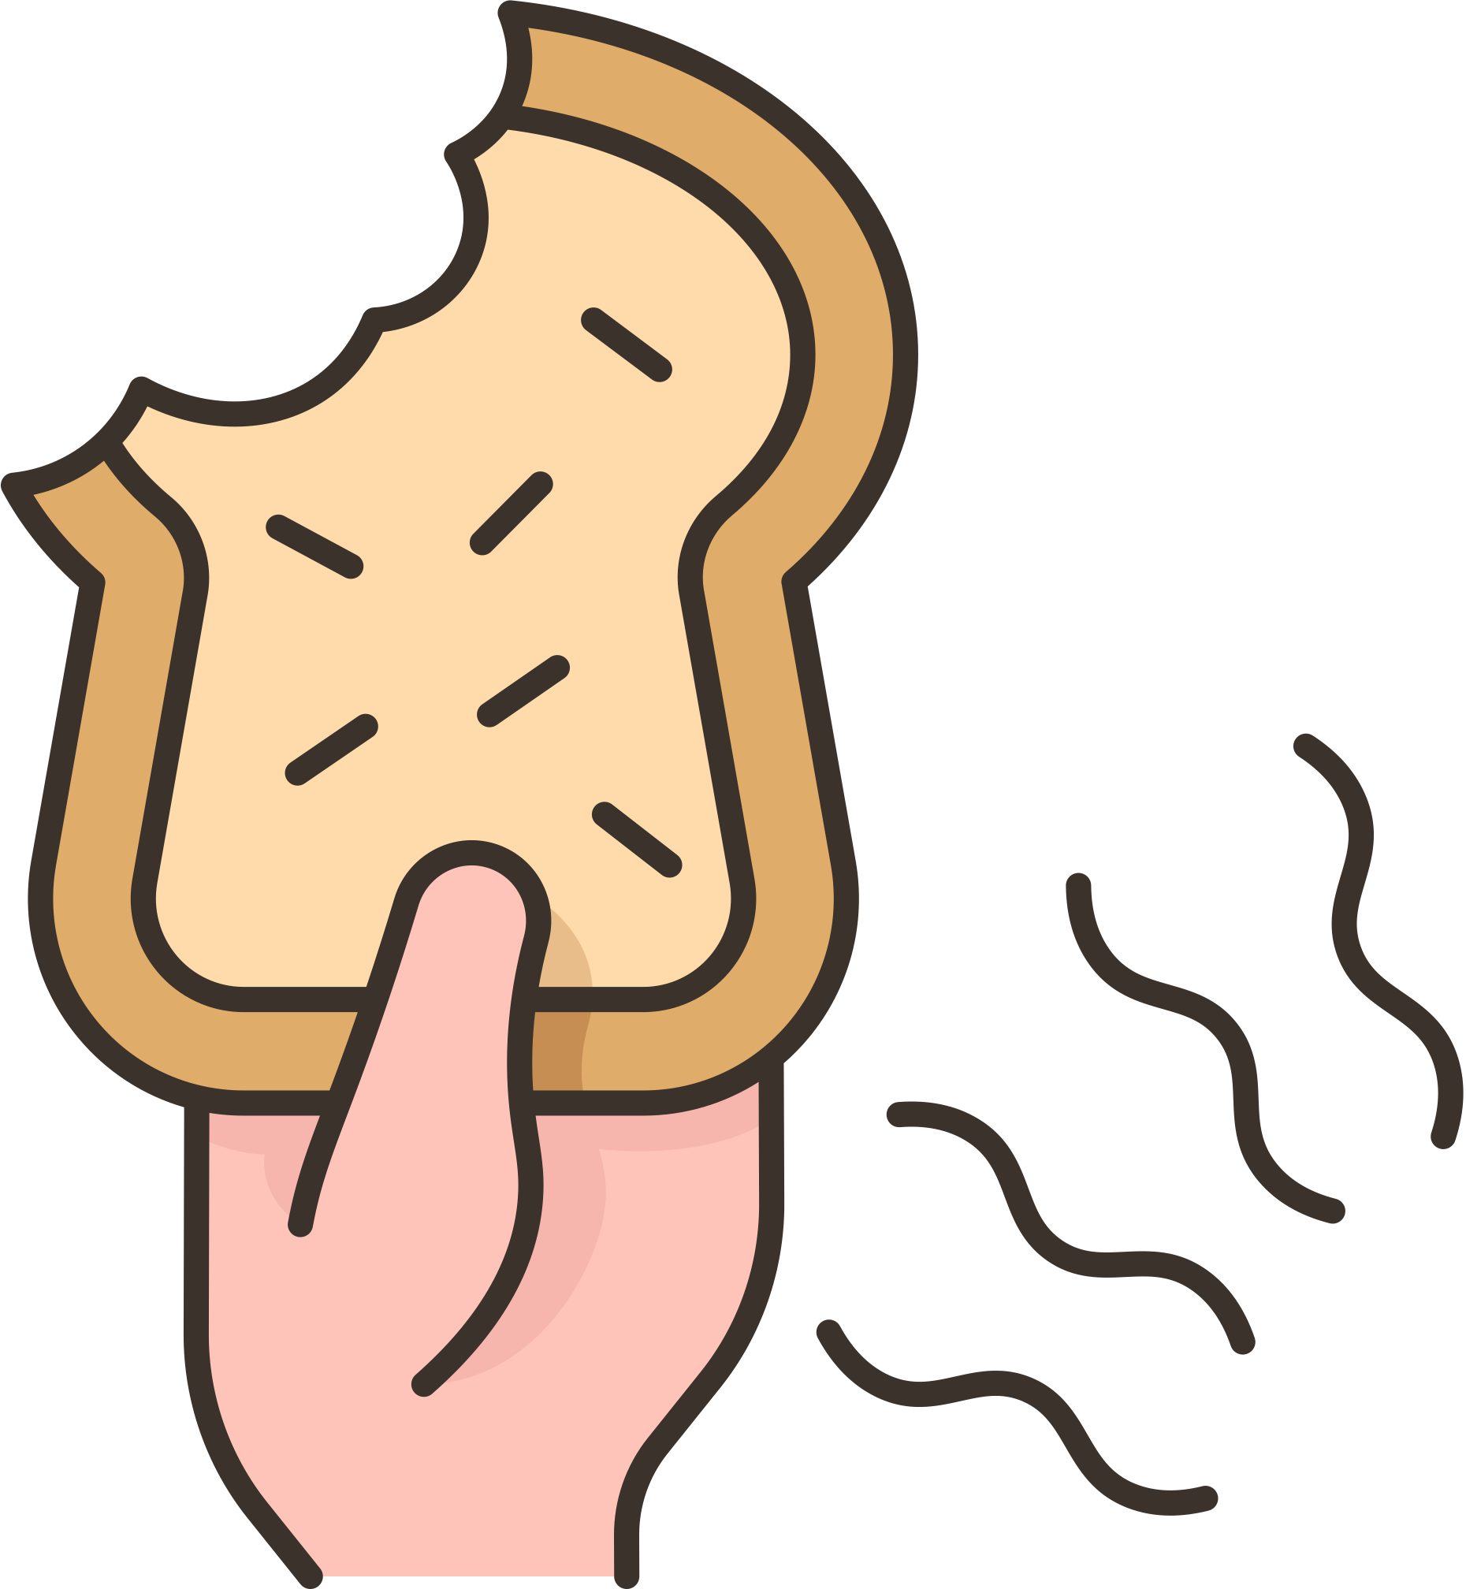


WHAT IS CELIAC DISEASE?
Celiac disease is a genetic autoimmune disease, meaning it's passed down through your family.
An estimated 1 in 100 people worldwide have celiac disease, but only about 30% are properly diagnosed.
When people with celiac disease eat gluten, it leads to damage in the small intestine.

Slide 3

HOW I WAS DIAGNOSED
[How old were you when you got diagnosed with celiac disease?]
[Did you go to the doctor because your stomach hurt, or some other reason?]
There is no medicine for celiac disease except to eat gluten-free.

Slide 4
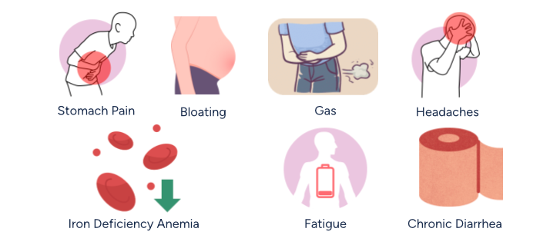
SYMPTOMS OF CELIAC DISEASE
Researchers and doctors say there are more than 200 symptoms.

Slide 5
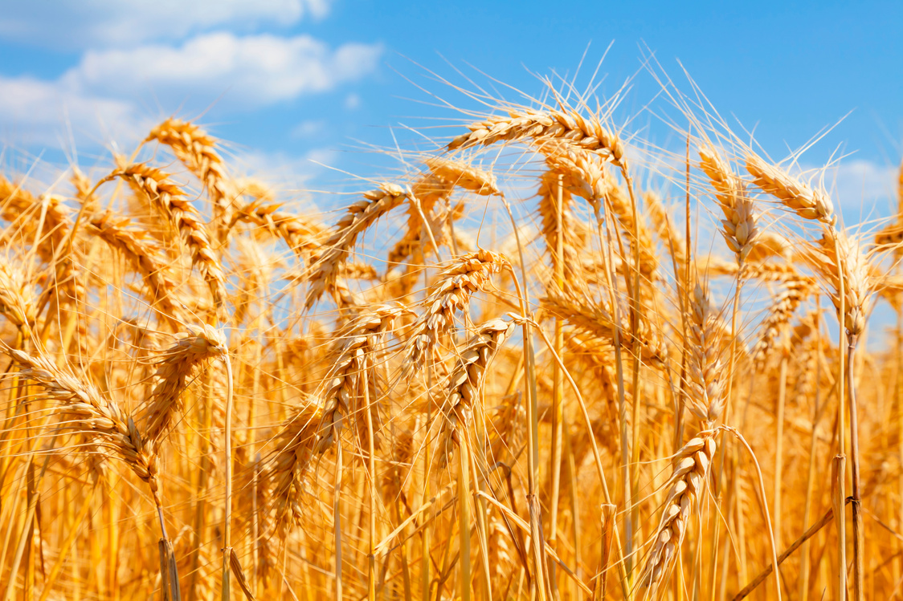
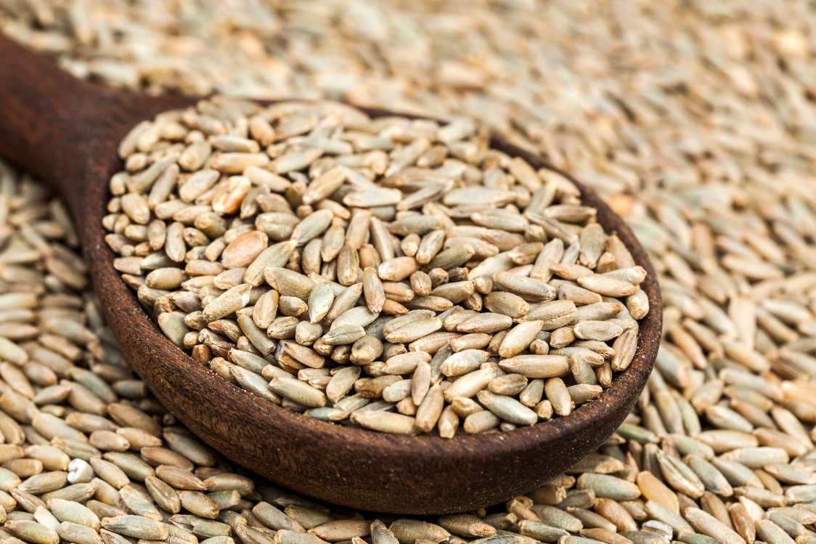
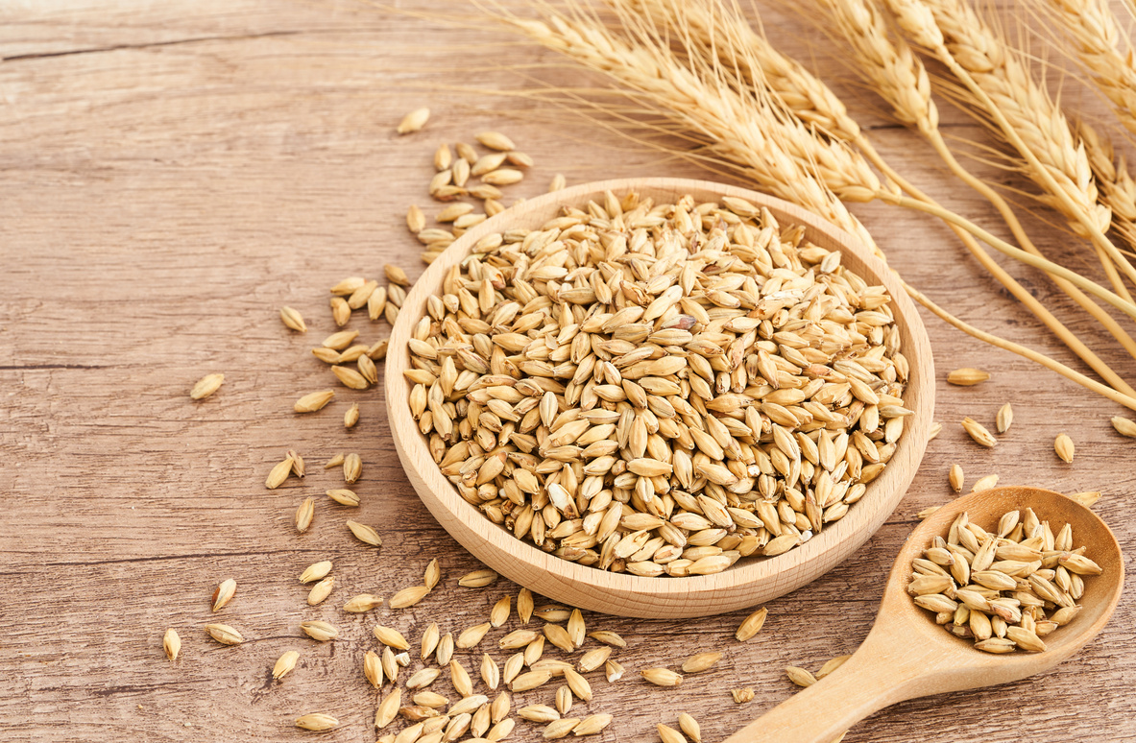
TREATMENT: A LIFELONG STRICT GLUTEN-FREE DIET
There are no medications or other treatments for celiac disease. There is no cure for celiac disease.
Wheat
Rye
Barley
Gluten is a protein found in all forms of wheat, rye, and barley. Gluten is like a glue that holds some foods together -- things like bread, pasta, and cookies, but it can also hide in soups, sauces, marinades, and seasonings.

Slide 6

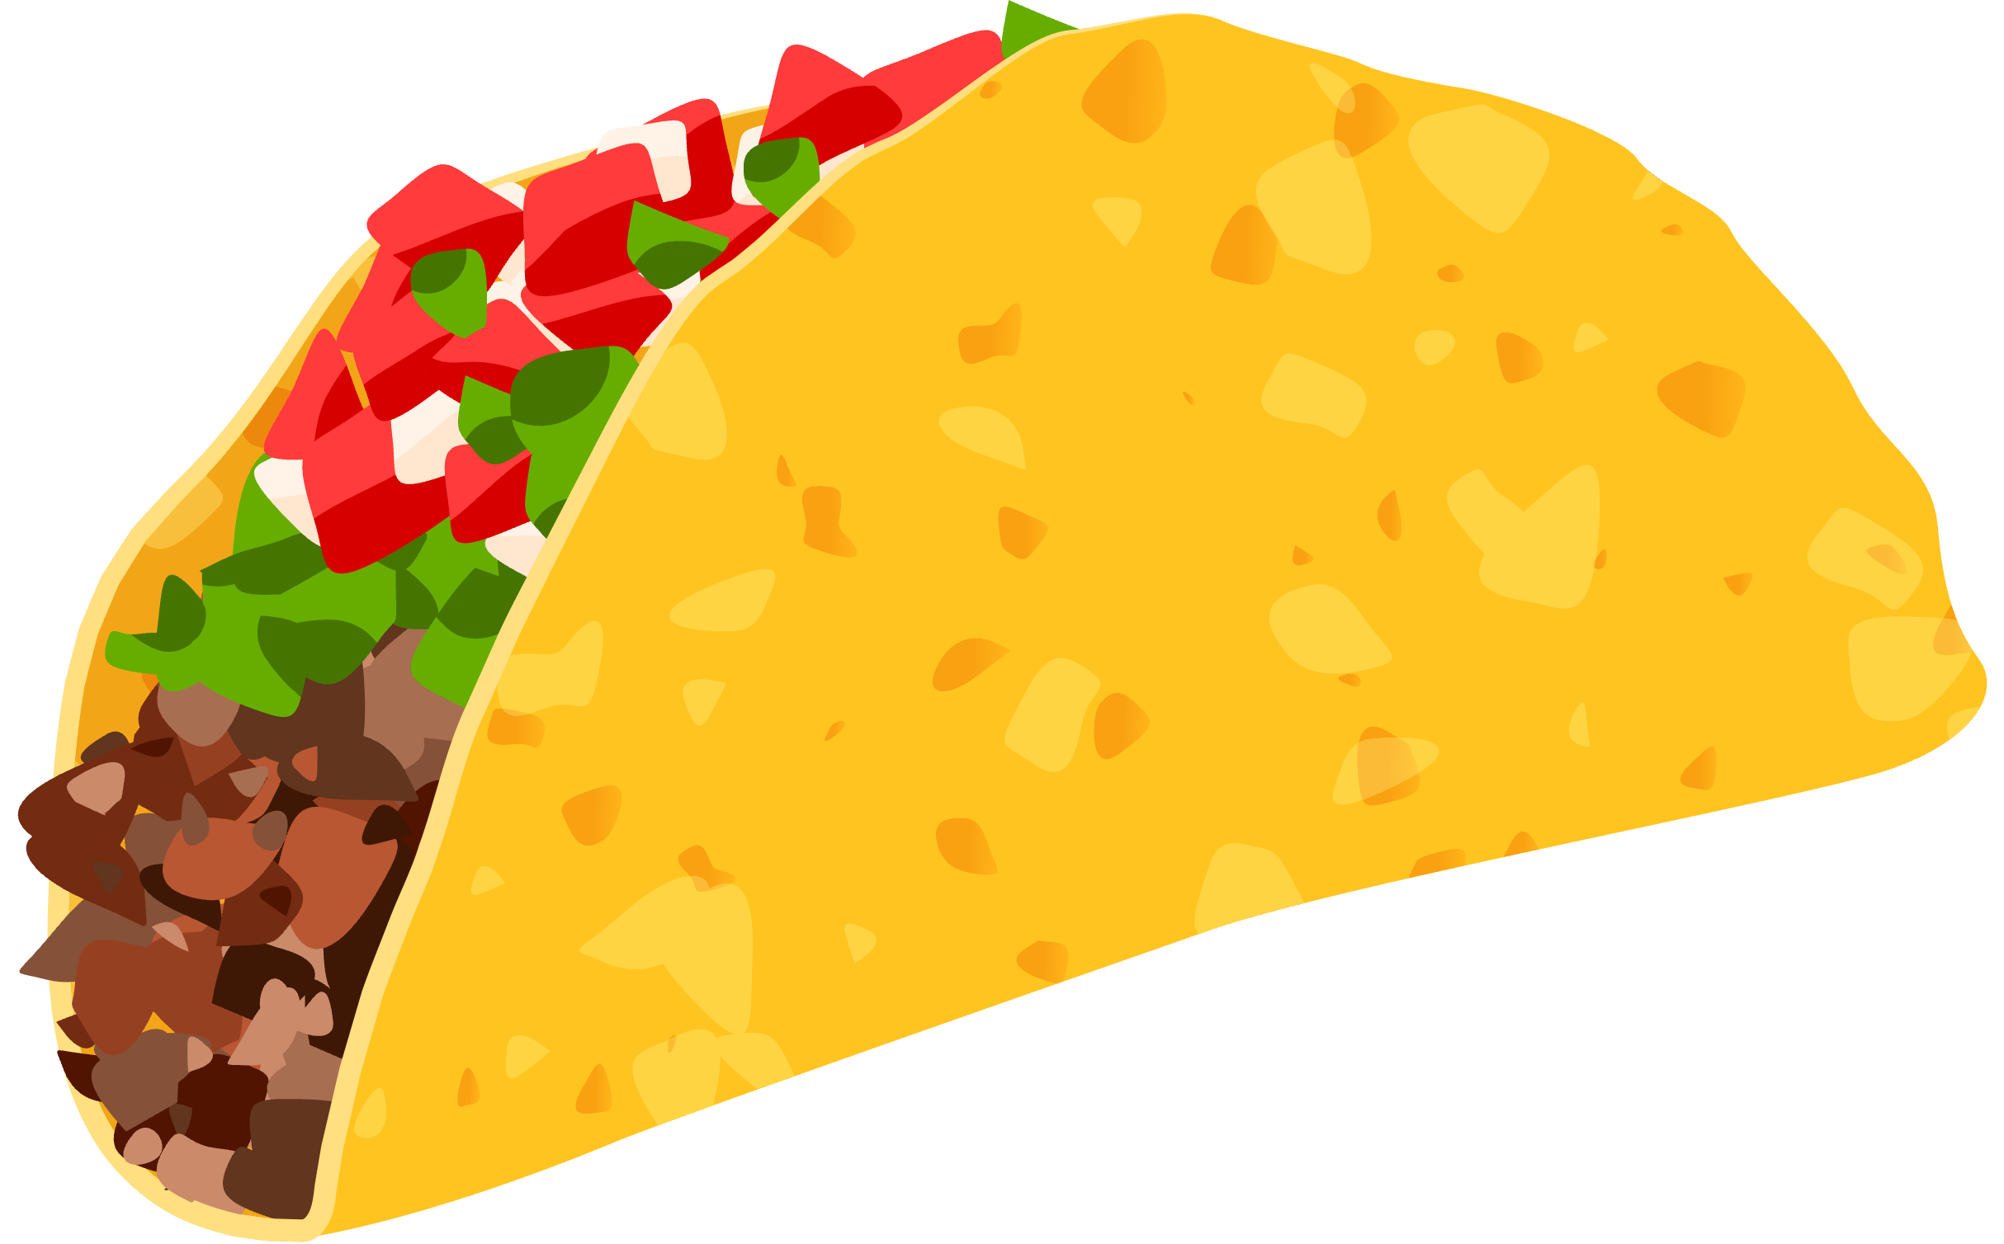
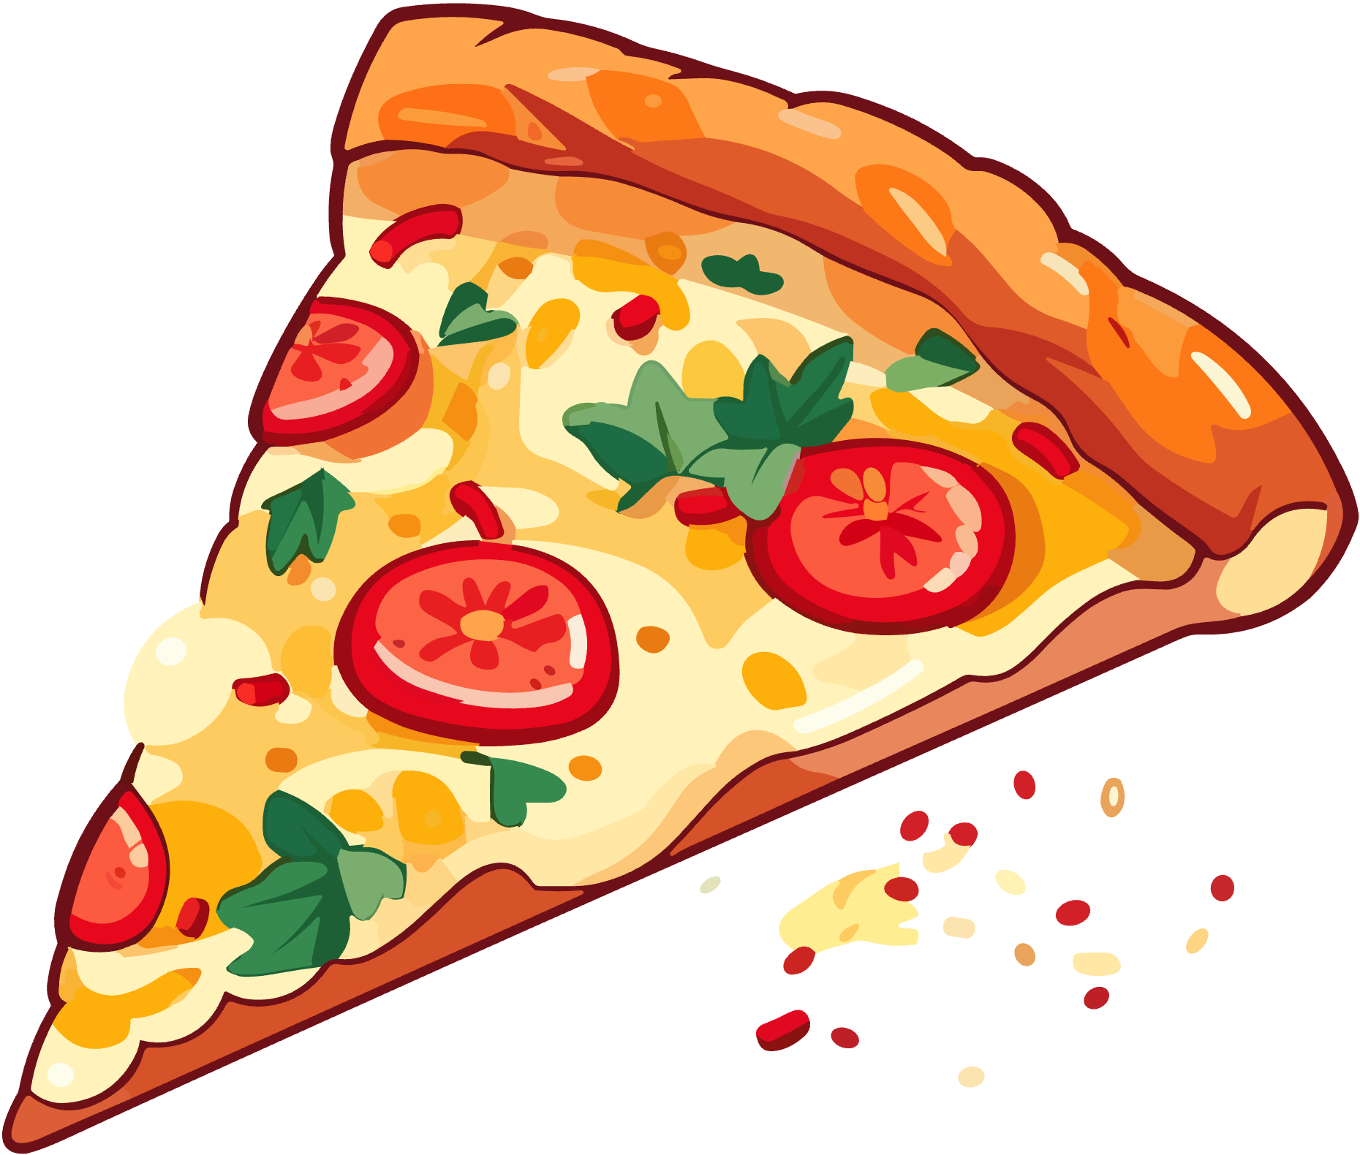
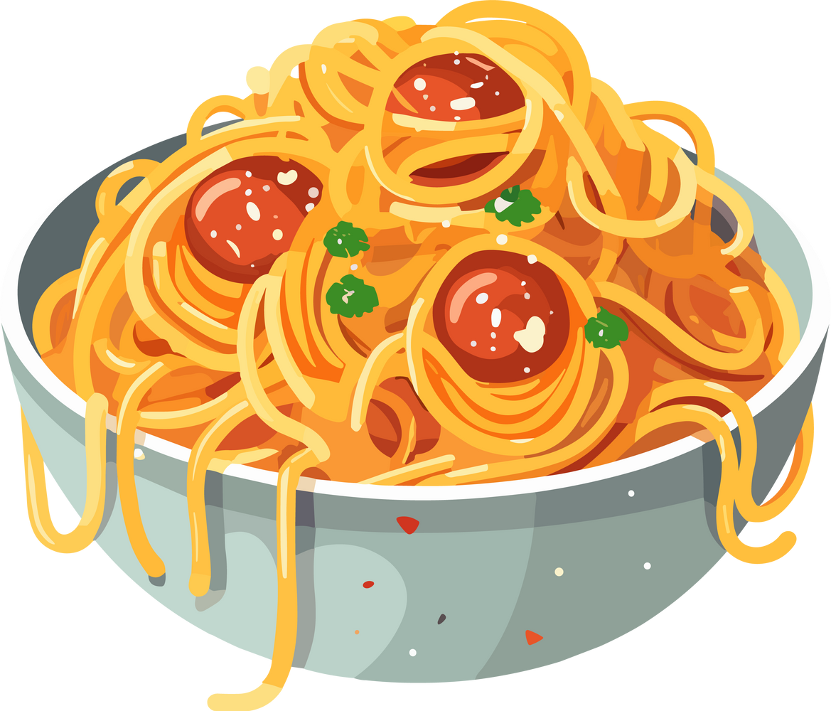
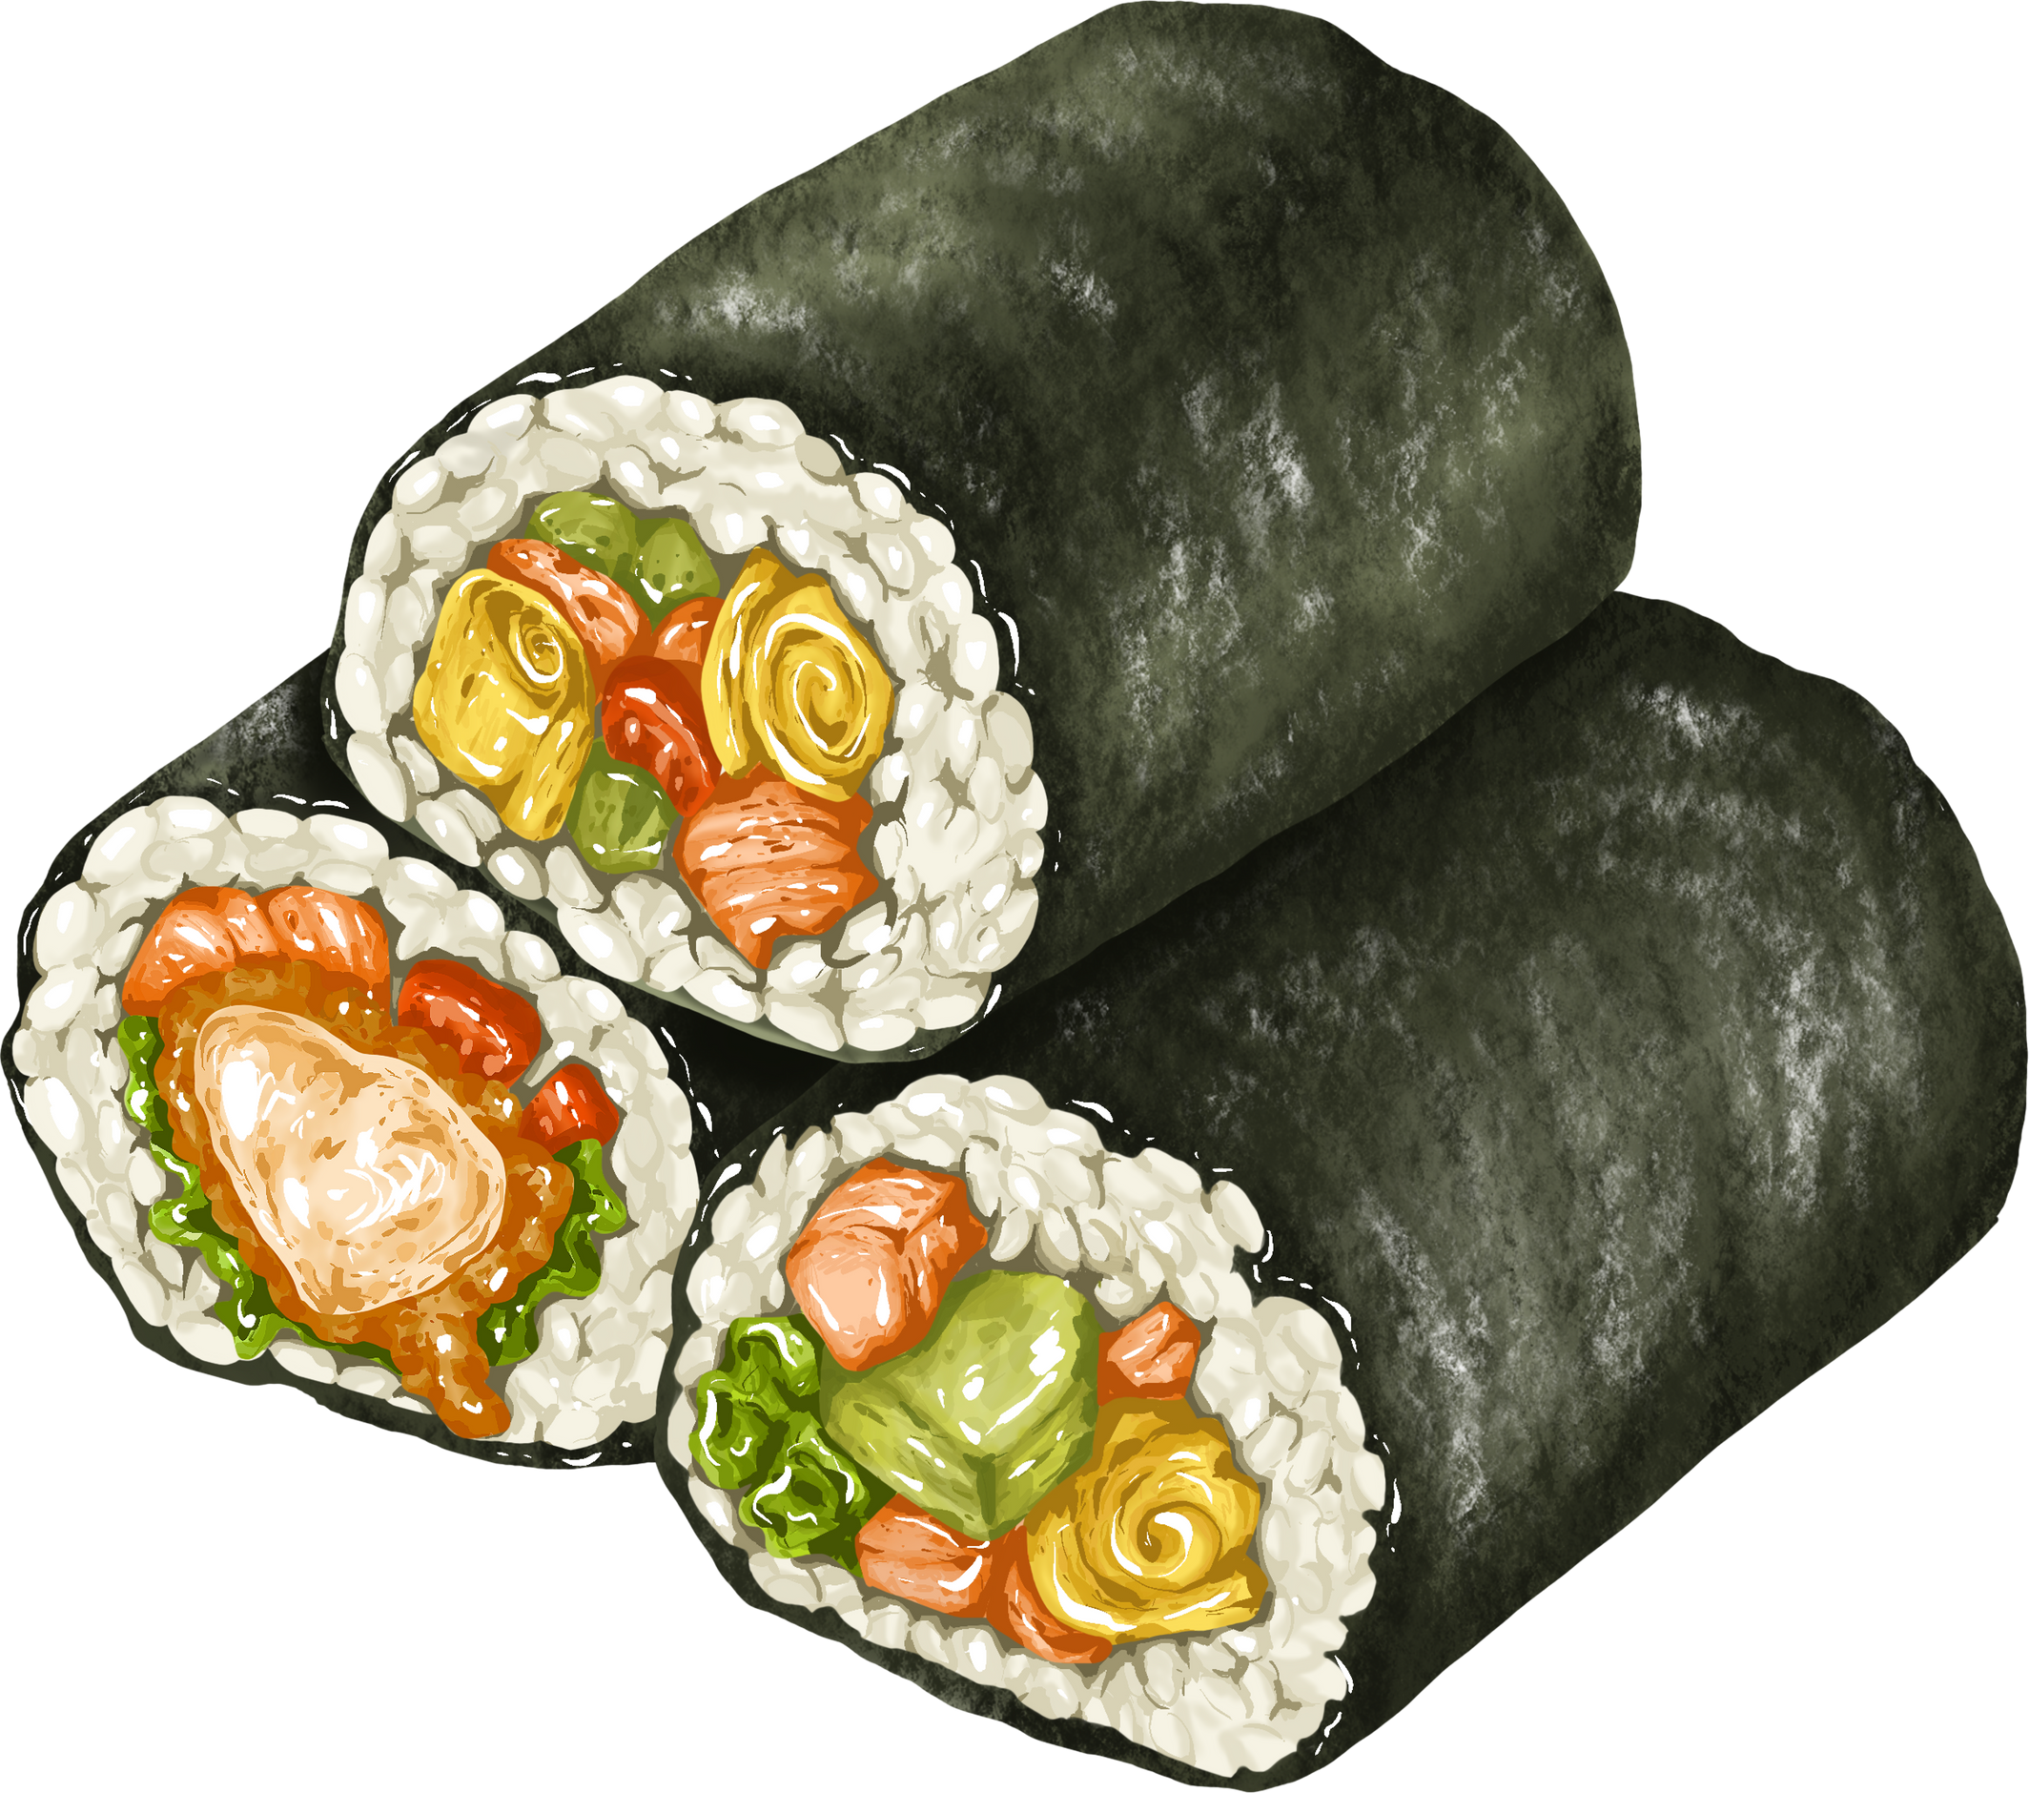

I LOVE GLUTEN-FREE FOOD!
[Insert a picture of you enjoying gluten-free food here!]

Slide 7
EATING GLUTEN-FREE KEEPS ME STRONG AND HEALTHY
[Insert a picture of you doing one of your favorite activities here!]

Slide 8

YOU CAN HELP ME MAKE A DIFFERENCE!
Until doctors find a cure for celiac disease, I have to eat gluten-free.
Tell a friend or a family member what you learned about celiac disease today!
The more people know about celiac disease, the easier it is for people like me to stay happy and healthy.

Slide 9
Thank You!!

